Slide 1
NorthWind Retail Data Analysis
PowerBI Dashboards

Slide 2
NorthWind Retail Dataset Ananlysis
Customer Analysis
Customers are spread across multiple countries, showing a wide global presence.
Most contacts are business roles like Owners and Sales Representatives, indicating B2B nature.
Strong repeat order behavior suggests solid customer engagement and loyalty.
Total orders are high, but the trend shows a gradual decline over time.
This fall may reflect seasonal demand changes or reduced purchasing activity.
Continuous monitoring is needed to identify the exact reason and prevent future dips.
Orders Analysis
Order Details Analysis
Most orders fall into mid-value price ranges, showing balanced purchasing behavior.
Discounts are used sparingly, meaning full-price sales drive most revenue.
A small set of high-value transactions significantly boosts overall revenue.
Product Analysis
Only a few premium products generate the majority of total revenue.
Best-selling items like Côte de Blaye have a disproportionate impact on sales.
Product portfolio has many items, but only select products truly drive performance.
Category Analysis
Beverages and Dairy Products are the strongest revenue-generating categories.
These categories consistently outperform others across sales metrics.
Lower-performing categories require strategic pricing or marketing support.
Supplier Analysis
A small number of suppliers contribute heavily to total product revenue.
Suppliers are mainly located in Europe and North America, showing regional concentration.
High dependency on top suppliers indicates both risk and negotiation advantage.
Employee Analysis
Workforce is small and primarily made up of Sales Representatives.
Employee distribution is mainly centered in the U.S., with limited global presence.
Organizational structure is sales-focused, reflecting business model priorities.
Shipper Analysis
Average delivery times differ significantly across shipping partners.
Some shippers consistently take longer, leading to overall shipment delays.
Choosing faster shippers can positively improve customer satisfaction and efficiency.

Slide 3
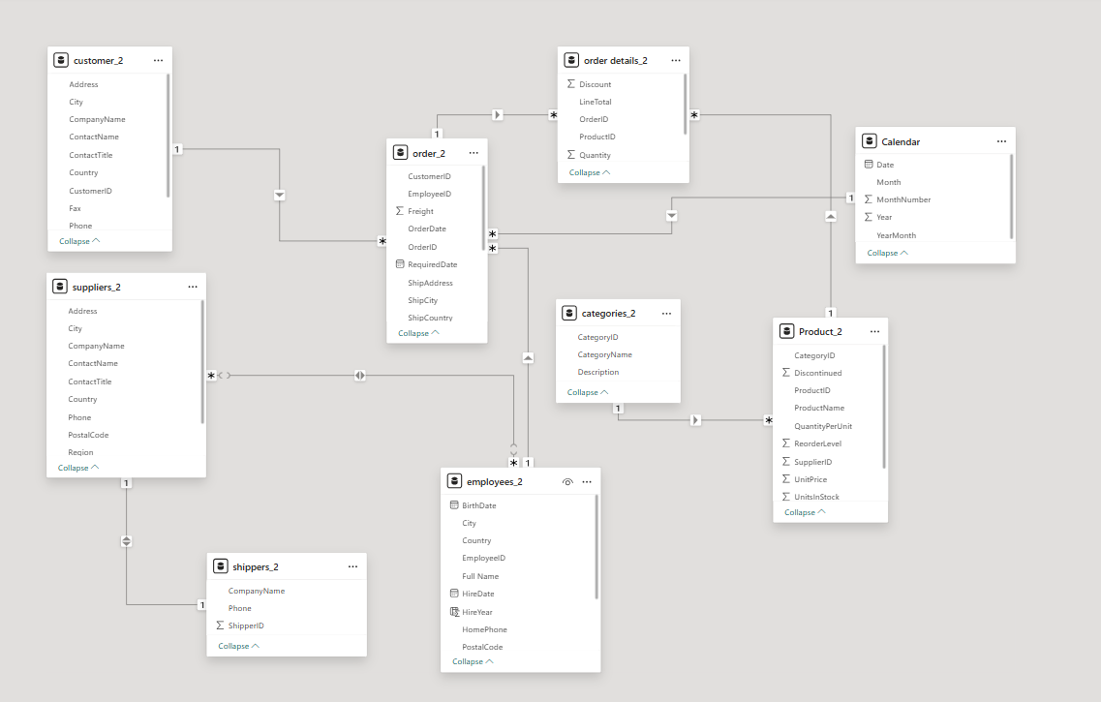
ER-Diagram /Data Modeling of NorthWind Retail Dataset

Slide 4
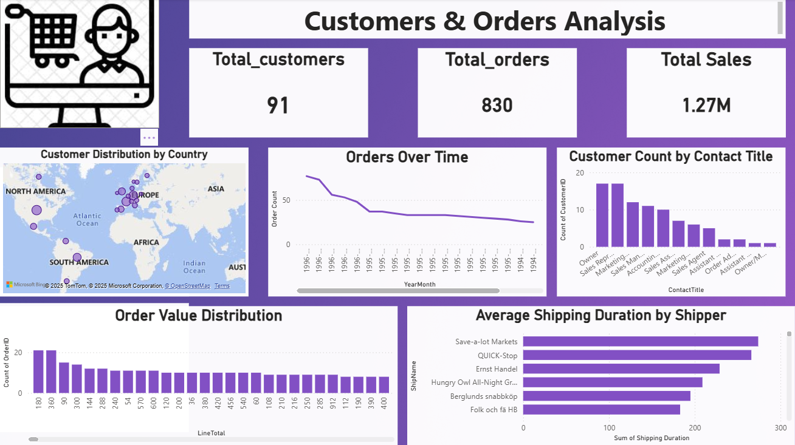

Slide 5
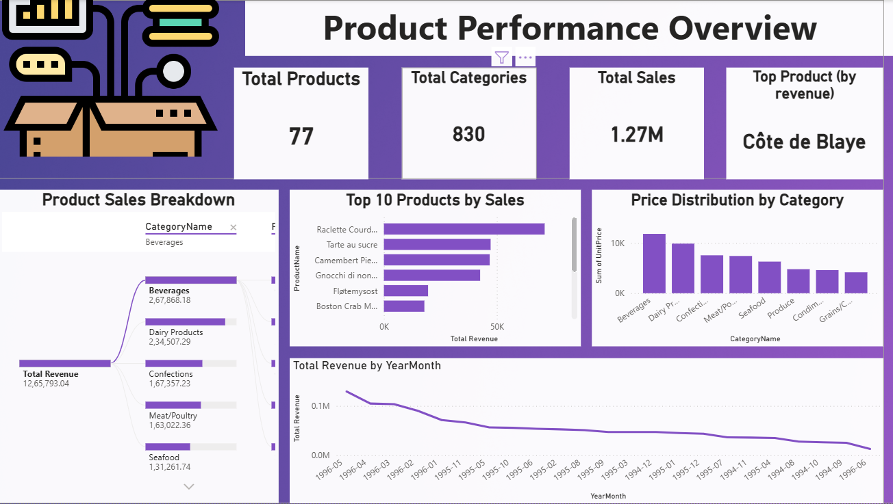

Slide 6
